Slide 1


Predicting Bitcoin Price Based On News Sentiment Analysis and Financial Metrics
CSE492 - Final Year Project
Aylin Irem Kara
Notes:
Hello everyone today I will present you Predicting Bitcoin Price Based On News Sentiment Analysis and Financial Metrics.

Slide 2

Outline
Introduction
Related Works
Analysis and Design
Data Preparation and Algorithms Implementation
Findings and Discussions
Conclusion
Future Work
Videos From GUIs
Notes:
I will start with an introduction, talk about my related work research, and then I will explain the study.

Slide 3
Introduction
Notes:
Let’s start with the introduction part.

Slide 4
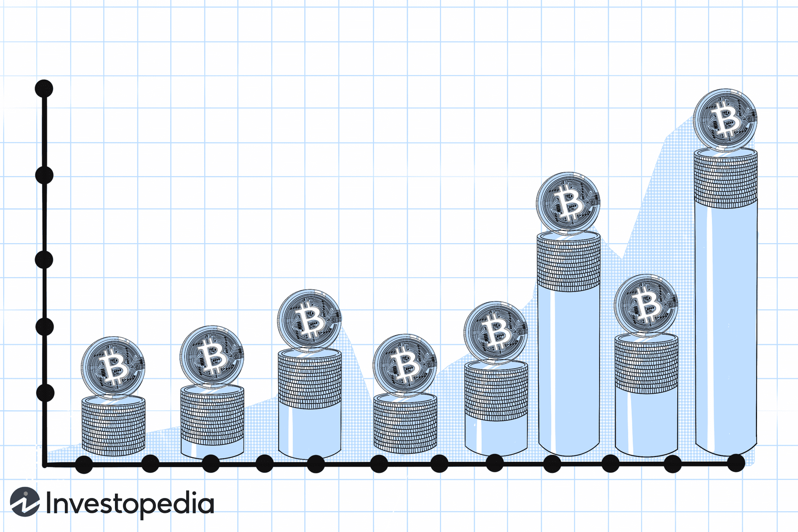
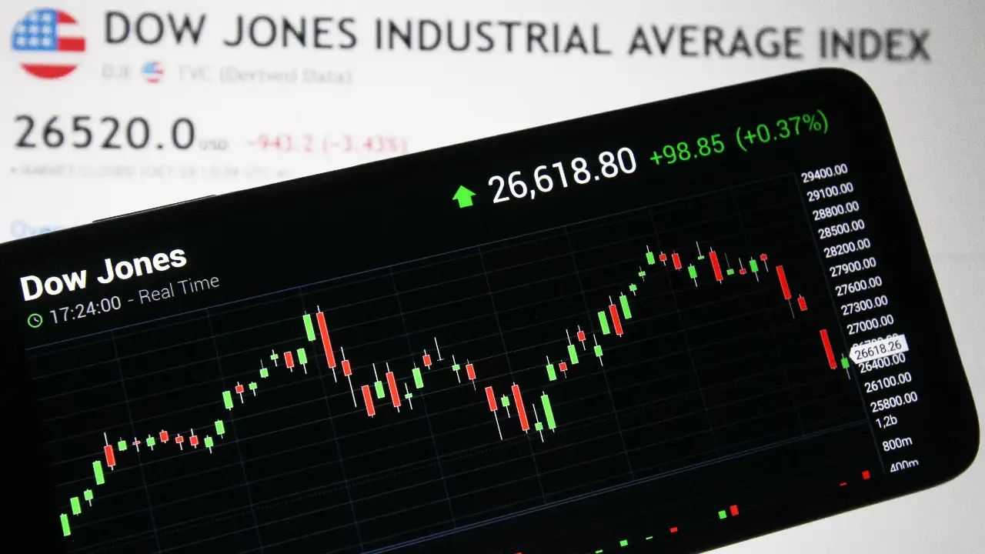

Why BTC price prediction is important?
How can we predict BTC price based on sentiment analysis?
Notes:
Bitcoin is the most popular cryptocurrency and its price is highly volatile. So, making accurate price predictions is an important challenge. For this reason, investors search for methods to predict prices. One of the options is sentiment analysis. In this study, we have worked on the prediction of BTC prices according to news sentiment analysis.

Slide 5

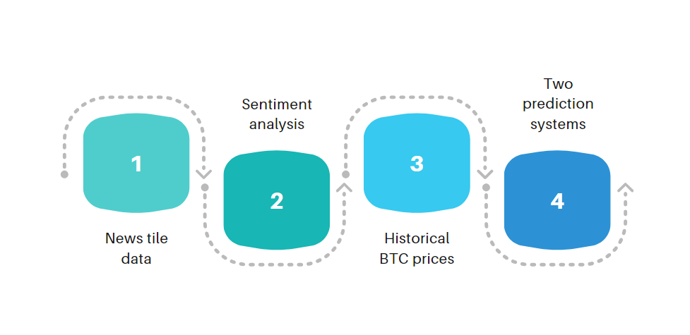
Our goal: Daily BTC Price prediction
Notes:
First, we collected news title data from the most popular crypto news website, then we applied sentiment analysis to the data. Also, we added historical BTC prices. We created two prediction systems and their GUIs. One is based on sentiment and BTC price, and the second one is based on sentiment, BTC price, USDI, and Dow Jones. In total, we made twelve different prediction models with ML algorithms.

Slide 6
Functional Requirements
Take news headline for first prediction system
Take news headline, USDI and Dow Jones for second prediction system
Take today’s BTC price
Text preprocessing and tokenization
Sentiment score calculation
Predict tomorrow’s BTC price
Give prediction as output
Non-Functional Requirements
Able to run all PC and web based notebook environment with Python3
Calculate and print prediction in 20 seconds for first prediction system
Calculate and print prediction in 16 seconds for second prediction system
Easy to use, minimal effort for users to navigate, just run cell for prediction
Notes:
Let’s continue with the requirements of the project. Let's explain some of the functional requirements. The system should take necessary inputs from the user for two prediction systems on prepared GUIs. And the input title should be preprocessed and tokenized. Also, there are some nonfunctional requirements. For example, the system should calculate and print the prediction in 20 seconds for the first prediction system and in 16 seconds for the second prediction system.

Slide 7
Related Works
Notes:
Let’s continue with the related works part.

Slide 8

Forecasting Bitcoin Price Fluctuation by Twitter Sentiment Analysis
Sattarov et al.[16]
92550 tweets
VADER for sentiment analysis.
Sentiment scores and historical price data of Bitcoin
Random Forest Classifier is used for prediction.
Average prediction error: 37.52%
Notes:
The first study I want to talk about is BTC price prediction based on sentiment analysis. Twitter data was used in this study. VADER was used for sentiment analysis. In the prediction model, they used Random Forest Classifier algorithm. They found the average prediction error of the prediction model was thirty-seven percent.

Slide 9
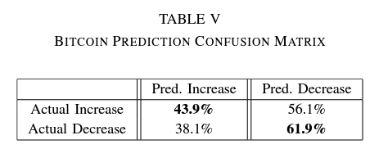
Cryptocurrency Price Prediction Using News and Social Media Sentiment
Lamon et al. [2]
The dataset provided from news and social media
Bitcoin, Ethereum and Litecoin
Prediction is made by Logistic Regression, SVM, Naive Bayes
Best classifier for BTC price prediction: Logistic Regression
Notes:
In the second study, the authors studied on price prediction system for three different cryptocurrencies. They worked on dataset with tweets, news headlines, and their sentiments. They used Logistic Regression, SVM, and Naive Bayes algorithms for prediction. The model prepared with Logistic Regression gave the best performance for BTC. By looking at the confusion matrix here, we can say that it predicts price decreases well.

Slide 10
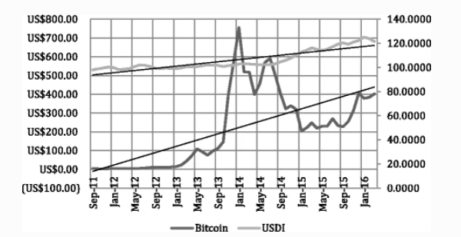
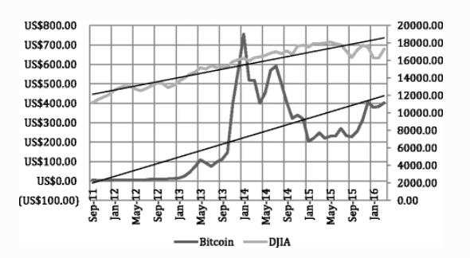
Analysis on the influence factors of Bitcoin’s price based on VEC model
Zhu et al.[26]
Different economic factors can have a relationship with BTC
USDI and DOW Jones has the strongest relationship with BTC compared to others in the study
Gold price has weak relationship with BTC
Notes:
And the latest study analyzes the correlation of different economic metrics with BTC prices. They stated that the most relevant metrics are USDI and Dow Jones among the values they researched. For this reason, we also added USDI and DJI as features in our second prediction model.

Slide 11
Analysis and Design
Notes:
We can move to Analysis and Design chapter.

Slide 12
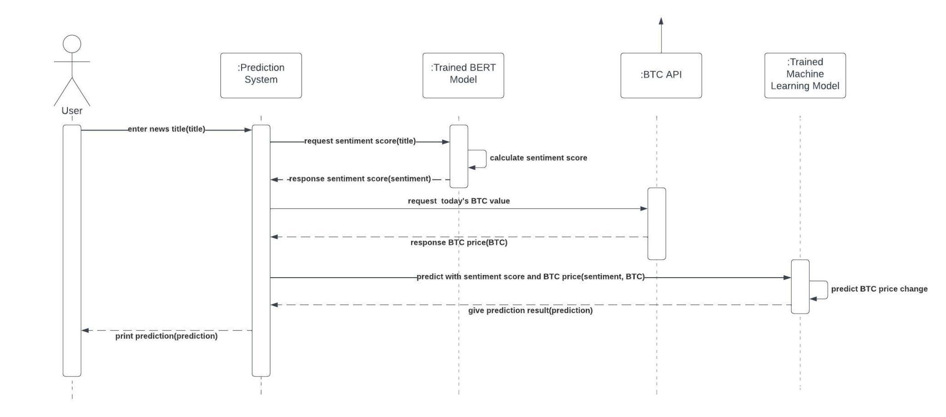
Sequence Diagram of First Prediction System
Notes:
Let’s continue with the sequence diagram of the first prediction system. This diagram shows us to sequenced events occur in this system. Firstly, the user enter news title and then, the system requests a sentiment score from the trained BERT model. And then, the sentiment score is calculated and gave to the system. After receiving the sentiment score, the system requests today’s BTC price from the API object. This object responds today’s BTC price. And finally, the prediction system requests the trained machine learning model for prediction. After receiving the prediction result, the output is printed.

Slide 13
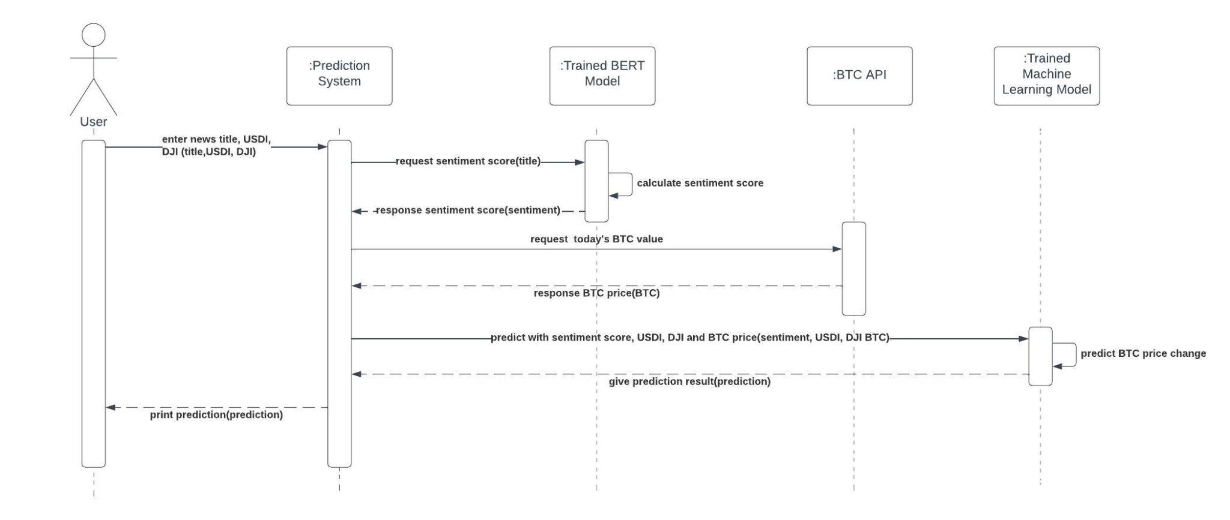
Sequence Diagram of Second Prediction System
Notes:
The second sequence diagram shows the events in the second prediction system. There is a structure similar to the previous slide. Differently, the user gives the title, USDI, and Dow Jones values to the system. This time, the system asks the trained ML model to predict based on sentiment, USDI, Dow Jones, and BTC price.

Slide 14
Pseudocode - First Prediction System
first_prediction_system_function():
import trained BERT model and tokenizer
import trained ML prediction model
take title input from user
request sentiment score from trained BERT model
request today’s BTC price from BTC API
request trained ML prediction model to predict with sentiment and price
print BTC price, title, sentiment score and prediction
Notes:
We also prepared the pseudocodes for both prediction systems. This pseudocodes shows us to necessary tasks done by the first prediction system in order. The tasks are the same for the sequence diagram generally. The pseudocodes starts with import BERT model and tokenizer tasks. After all necessary tasks are done the system print BTC price, title, sentiment and prediction.

Slide 15
Pseudocode - Second Prediction System
second_prediction_system_function():
import trained BERT model and tokenizer
import trained ML prediction model
take title, USDI and DJI input from user
request sentiment score from trained BERT model
request today’s BTC price from BTC API
request trained ML prediction model to predict with sentiment, USDI, DJI and price
print BTC price, title, sentiment score and prediction
Notes:
And, this pseudocodes shows us to necessary tasks done by the second prediction system. The tasks provides the system functionality as you can see. The necessary tasks for the second prediction is shown in order.

Slide 16
Data Preparation and Algorithms Implementation
Notes:
We can move to Data Preparation and Algorithms Implementation part.

Slide 17
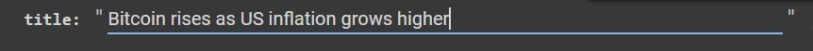
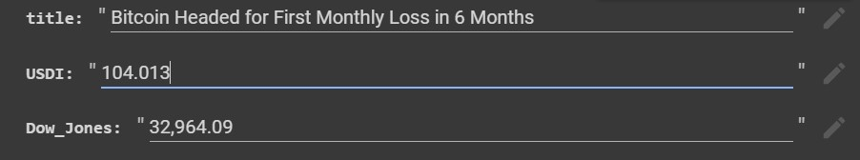
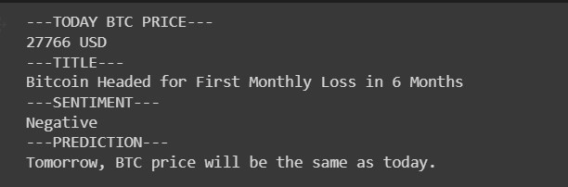
Input for First Prediction System GUI:
Input for Second Prediction System GUI:
Output for Both Prediction Systems GUI:
Notes:
As I said before, we created two GUIs for the prediction systems. The screenshots are taken from the GUIs. The first photo shows us to title input for the first prediction system. And the second one shows the necessary inputs from the user. The inputs are title, USDI, and Dow Jones. For both GUIs, after taking inputs, the system gives output. The third photo shows the BTC price taken BTC API, title taken from the user, the sentiment calculated by the BERT model and finally, the prediction. The prediction is provided by the imported ML model.

Slide 18
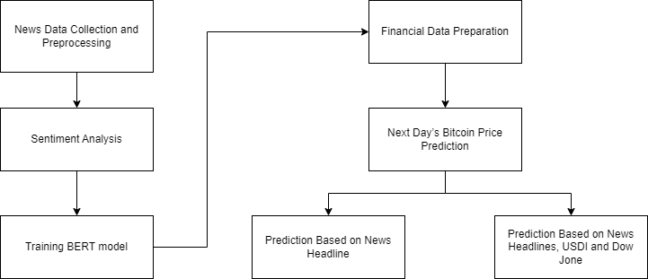
Data Preparation and Implementation Flowchart
Notes:
Let’s continue with this flowchart. I will explain the processes you see in this slide. In this chapter, I will provide information about all of the tasks in these steps one by one.

Slide 19

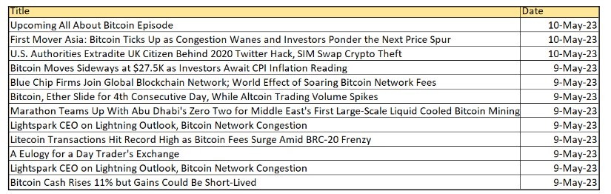


News Data Collection and Preprocessing
From: March 11, 2020, To: May 10, 2023
Example screenshot from collected data
Notes:
Let’s start with the first process. We scraped the news titles from CoinDesk website. This data consists of all the related BTC news titles from the eleventh of March 2020 to the tenth of May 2023. We used Selenium and BeautifulSoup tools for web scraping. Also, we created a data frame for the dataset thanks to the Pandas library.

Slide 20
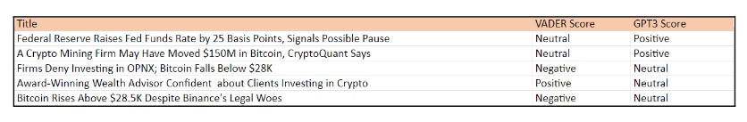
Sentiment Analysis
VADER, GPT-3, TextBlob and CryptoBERT are used.
VADER and GPT-3 Comparison
Notes:
After, we utilized sentiment analysis by VADER, GPT-3, TextBlob, and CryptoBERT. When we looked at the results of these methods and the algorithms we used, we realized that VADER made the most proper classification of sentiments in terms of meaning. For this reason, we used the data prepared by VADER in the study.

Slide 21
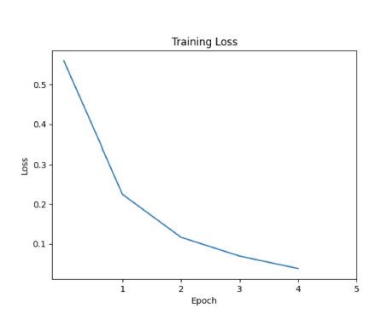
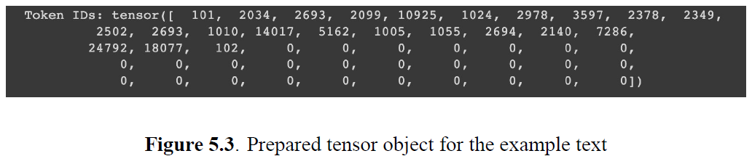
Training BERT Model
BERT tokenizer is imported
Input vector’s length is 50 which is the maximum title length
80% → training; 20% → test
Batch size: 32, epoch number: 5
F1 Score: 0.92
Notes:
We trained the BERT model with our own data to obtain domain-specific sentiment classification model. We used titles and VADER-scored data to train the BERT model. The BERT tokenizer is imported into the code. The titles are tokenized and converted into vectors. The batch size is selected as thirty-two and the epoch number was five. The F1 Score is calculated as ninety-two percent. And there is a screenshot from training loss based on the epoch numbers.

Slide 22
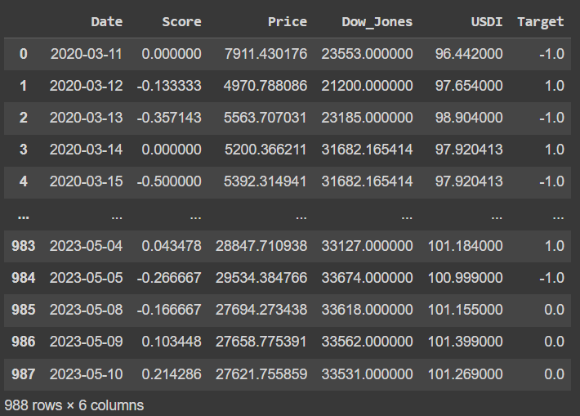
Financial Data Preparation
YahooFinancials Python module is used for BTC historical data
USDI and Dow Jones historical data
Average daily sentiment score → Score column
Next day price change compared to relevant day → Target column
-1: price will decrease
1: price will increase
0: price will be same
Notes:
In order to obtain BTC historical prices, YahooFinancials Python module is used. Also, we take the historical USDI and Dow Jones historical data from the web. In order to combine the datasets, the daily averages of sentiment scores were taken. There is a newly added column which is the target. This column represents the price change of the next day according to the relevant day.

Slide 23

Next Day’s BTC Price Prediction
First Prediction System’s ML Models
Feature variables:
Price and sentiment scores
Second Prediction System’s ML Models
Feature variables:
Price, USDI, Dow Jones, and sentiment scores
Target column is selected as target variable for both
Notes:
In order to predict BTC prices daily, the ML models are created for two systems. For first system’s ML models, the features are selected as price and sentiments. On the other hand, for the second system’s ML models, the features are selected as price, sentiments, USDI, and Dow Jones. The target variable was the target column for all models.

Slide 24
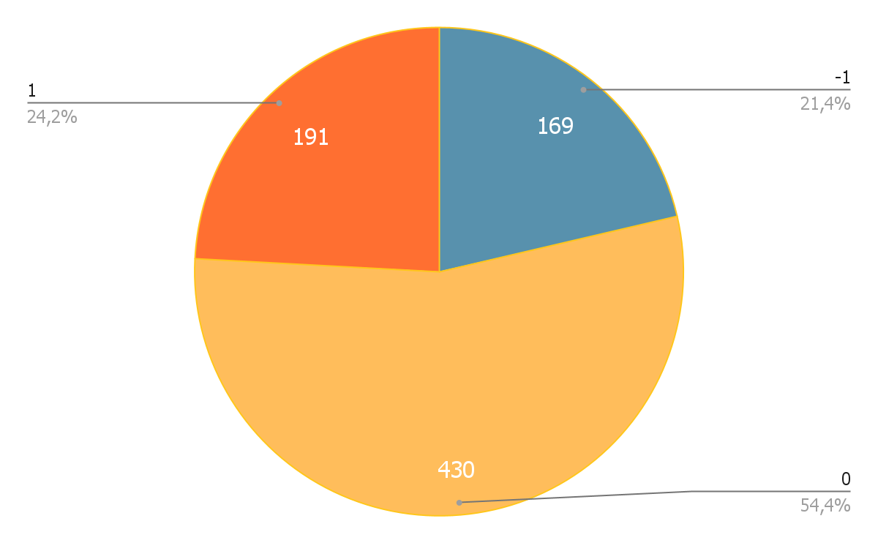
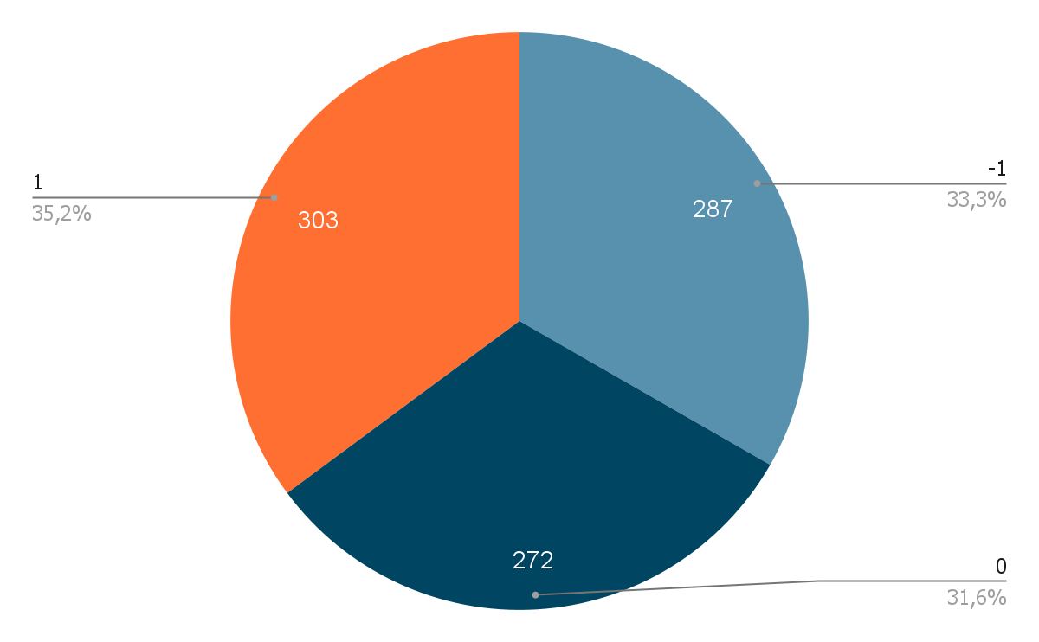
Resampling Method: SMOTE-Tomek
Original training data
Balanced training data
classes → 0: neutral; 1: positive; -1: negative
Notes:
Our training data has a more neutral title compared to the other classes. So, we used a resampling method named SMOTE-Tomek for obtain balanced training dataset. You can see the sample number in the three different classes in the original and balanced training dataset.

Slide 25
Findings and Discussion
Notes:
We can move to the Findings and Discussion topic.

Slide 26
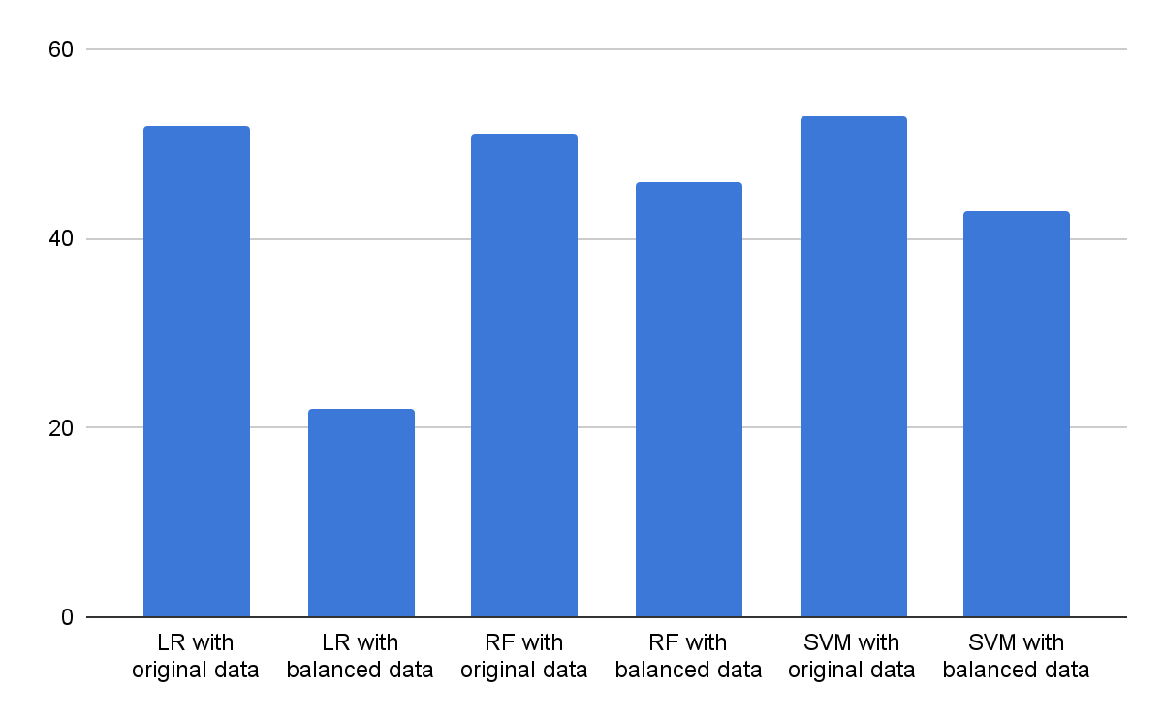
First Prediction System - Algorithms Evaluation
Accuracy Values(%) of Prediction Models
RF models and SVM model with balanced data can classify all classes.
LR model with original data can only classify ‘0’ class.
SVM model with original data model can only classify ‘0’ class.
LR: Logistic Regression model
RF: Random Forest model
SVM: Support Vector Machine model
Notes:
You can see the prediction model’s accuracy values for the first prediction system. Algorithms were trained with both original data and balanced data. When we compare by looking at the accuracy, the SVM with the original data model has the highest accuracy value. Although it has the highest accuracy, it could only classify in the ‘0’ class. In addition, RF models and SVM with balanced data models do not have the highest accuracy, but they are successful because they can classify in all three classes.

Slide 27
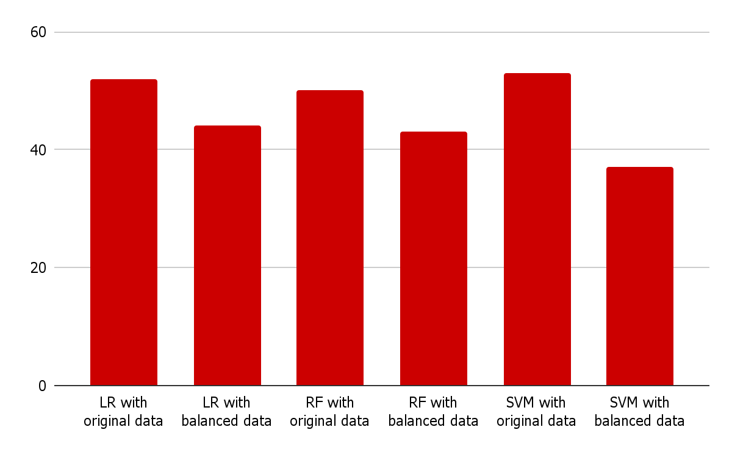
Second Prediction System - Algorithms Evaluation
Accuracy Values(%) of Prediction Models
LR model with balanced data, RF models and SVM model with balanced data can classify all classes.
LR model with original data can only classify ‘0’ class.
SVM model with original data model can only classify ‘0’ class.
LR: Logistic Regression model
RF: Random Forest model
SVM: Support Vector Machine model
Notes:
Let’s continue with the second prediction system models. These are all of the prepared models accuracy values for this system. The SVM model trained with the original data model gave the best accuracy. Logistic Regression model with balanced data, Random Forest models, and support vector machine model with balanced data can classify all classes.

Slide 28

Two Scenarios for Evaluation
First Scenario : who wants to buy BTC
Consider → avoid below case:
Actual value: decreasing (‘-1’ value)
Predicted value: increasing(‘+1’ value)
Second Scenario : who wants to sell BTC
Consider → avoid below case:
Actual value: increasing(‘+1’ value)
Predicted value: decreasing (‘-1’ value)
Notes:
In the evaluation, we created two scenarios and considered confusion matrices. The first scenario is prepared for the user who wants to buy BTC. According to this scenario, we found models with the lowest values in the confusion matrix where the actual value is minus one but the predicted value is plus 1. We prepared the second scenario for users who want to sell BTC. We avoided the predicted value being minus one while the actual value was plus one in the confusion matrix. Thus, we aimed to predict with the minimum loss for both scenarios.

Slide 29
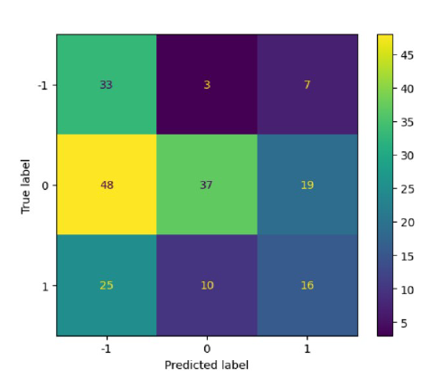
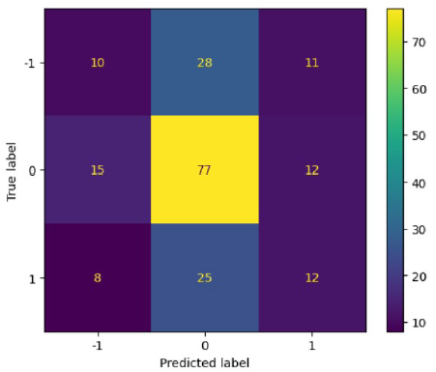
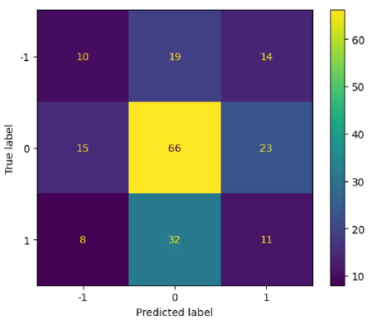
First Prediction System - Evaluation for Scenarios
First Scenario: user wants to ‘BUY’
SVM model with balanced data is most appropriate
SVM with Balanced Data
Random Forest with Original Data
Random Forest with Balanced Data
Notes:
Based on the scenarios I mentioned, let's look at the first prediction system. There are three models that can make predictions in all three classes from the prediction models. Considering the confusion matrices, according to the first scenario, the SVM model with balanced data is the most suitable model. You can see the avoided cases by orage arrows.

Slide 30
First Prediction System - Evaluation for Scenarios
Second Scenario: user wants to ‘SELL’
RF models most appropriate
SVM with Balanced Data
Random Forest with Original Data
Random Forest with Balanced Data
Notes:
According to the second scenario, RF models are the most suitable models when looking at confusion matrices. We can see the avoided cases in these pictures. RF models have eight cases but SVM model has twenty five cases.

Slide 31
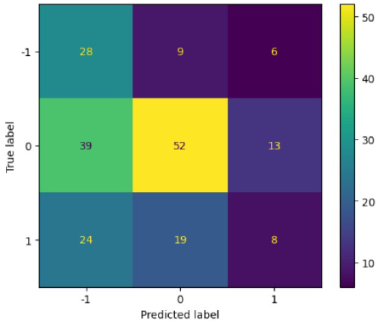
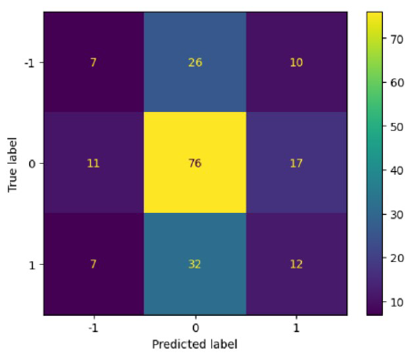
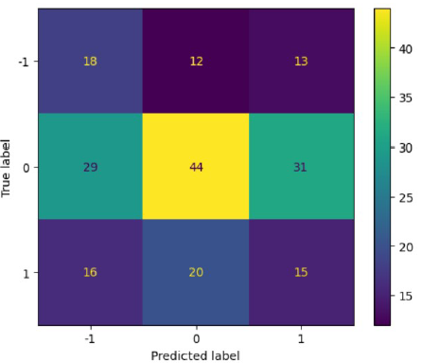
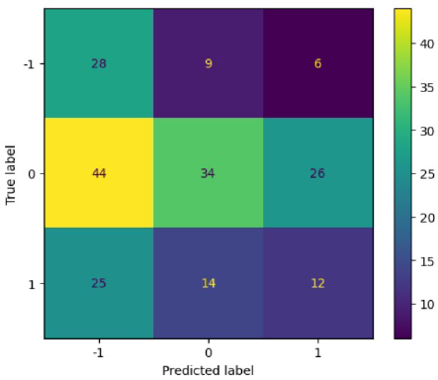
Second Prediction System - Evaluation for Scenarios
First Scenario: user wants to ‘BUY’
LR with balanced data and SVM with balanced data models are most appropriate
LR with Balanced Data
RF with Original Data
RF with Balanced Data
SVM with Balanced Data
Notes:
Let's move on to the second prediction system. When we look at confusion matrices for the first scenario, logistic regression with balanced data and SVM with balanced data models are the most suitable. Because they gave less avoided cases.

Slide 32
Second Prediction System - Evaluation for Scenarios
Second Scenario: user wants to ‘SELL’
RF with original data model is most appropriate
LR with Balanced Data
RF with Original Data
RF with Balanced Data
SVM with Balanced Data
Notes:
If we evaluate for the second scenario, the cases we should avoid are least at random forest trained with the original data model. This model has only seven avoided cases as you can see in the confusion matrix. Other confusion matrices have more avoided cases.

Slide 33
Conclusion
Notes:
Finally, we can move to the conclusion part.

Slide 34
BS4 and Selenium→ 12520 news title from Coindesk
VADER, GPT-3, TextBlob and CryptoBERT → VADER
SMOTE-Tomek → Classification performance in three classes
First Prediction
System
Second Prediction
System
First Scenario
BUY
Second Scenario SELL
First Scenario
BUY
Second Scenario SELL
SVM model with balanced data
RF models
RF models
LR model with balanced data
SVM model with balanced data
Notes:
In this study, we scraped over twelve thousands titles from Coindesk. After that, we applied the most suitable sentiment analysis method which is VADER. Because the data is imbalanced, we used the SMOTE-Tomek method. So we obtained balanced training data. After preparing datasets, we created two prediction systems. First one is based on title and price. The second is based on title, price, USDI, and Dow Jones. In the evaluation, we considered the accuracy values and confusion matrices. We evaluated the models for the prepared two scenarios. And most suitable models are implemented on the systems for the scenarios. As I mentioned before, the accuracy values are nearly fifty percent. So with this research, altough we used state of the art methodologies, sentiment of news, Dow Jones and USDI does not provide really high accuracy values. The BTC prices depends on several factors and prediction prices is challenging task.

Slide 35
Future Work
Notes:
Let’s look at future work that we can apply.

Slide 36


Using bigger dataset
Adding more relevant financial metrics as features
Training the prediction model with balanced data
Notes:
Firstly, we can work with a bigger dataset. Also, we can add more features such as relevant economic metrics. Collecting data with an equal number of samples from all classes is also an option. These solutions can improve the prediction performance of our model.

Slide 37
Videos From GUIs

Slide 38
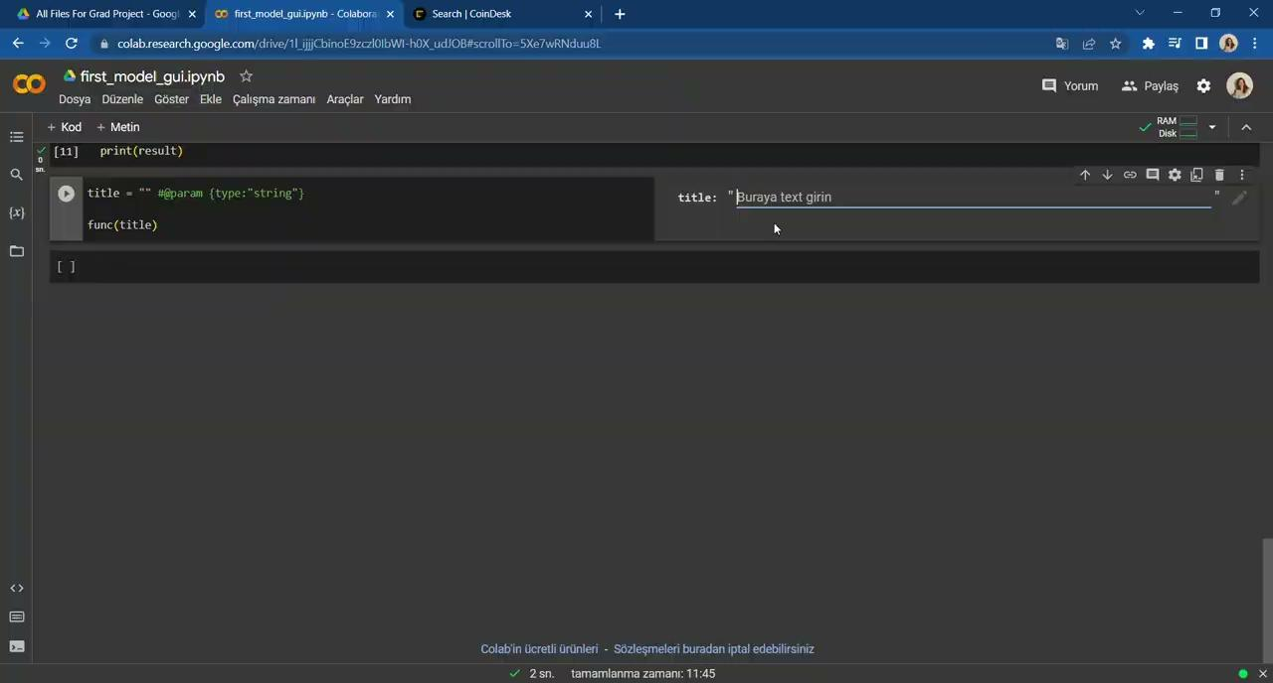
First Prediction GUI
Notes:
Let’s see the video of the first prediction GUI that was mentioned. The user gives title and the output is printed.

Slide 39
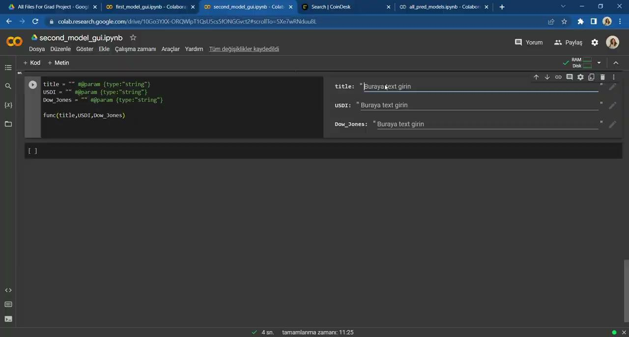
Second Prediction GUI
Notes:
This is the second prediction GUI video also. The user gives title, today’s USDI and Dow Jones values. The system prints the necessary output.

Slide 40
Thank you for listening!
Aylin İrem Kara
Notes:
Thank you for listening and consideration. I would like to thank Tacha hoca and Burcu hoca for supporting me for months.

